Slide 1
SC1004 Part 2
Lectured by Prof Guan Cuntai
(teaching materials by Prof Chng Eng Siong)
Email: ctguan@ntu.edu.sg

Slide 2
Quiz 2 and Exam:
Quiz 2
- Coverage : Ch 6 ,7, 8 - Time/Date: Week 13, last lecture time (10:30-11.20am, 17th April 2024)
2. Final Exam
- Coverage : Ch 6, 7, 8 (Q3 & Q4)
- Date/Time: 2 May 2024 (Thursday), 1.00-3.00pm
(Ch 9 will not be tested)

Slide 3
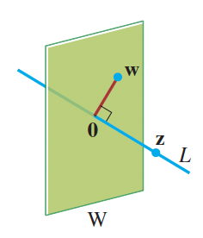
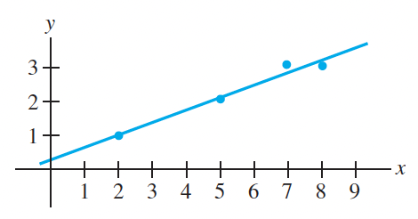
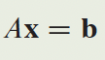
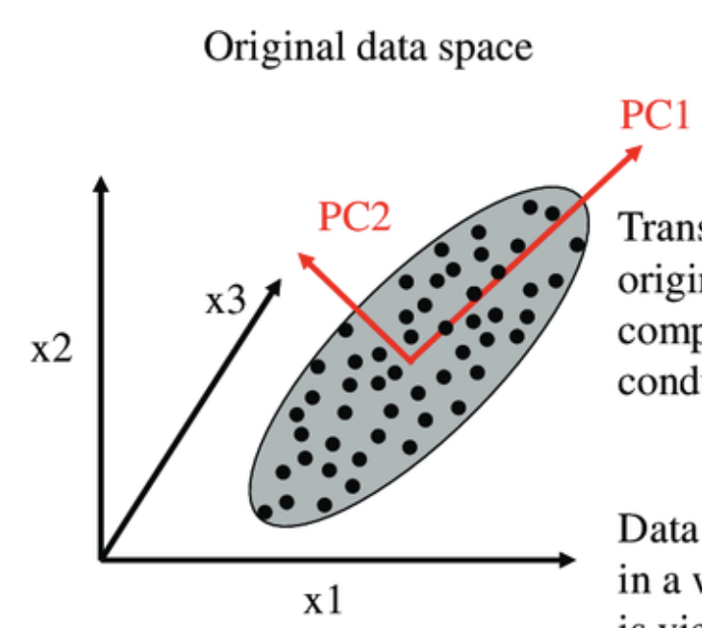
Syllabus for Part 2
Chapter | Topics | Week (Lecture) | Week (Tut)
6 | Orthogonality | 8-9 | 9-10
7 | Least Squares | 9-10 | 10-11
8 | EigenValue and Eigenvectors | 11-12 | 12-13
9 | Singular Value Decomposition (SVD) | 13
Table 1: schedule

Slide 4
Online Video learning Schedule
https://www.youtube.com/channel/UCBzG5jg3huxiPkCt-Serrjw
Week | Part | Topic | Notes
8 | 6.1.1-6.2.3 | Orthogonality, Normalization, Dot-Product, Inequalities, | Lecture 1: 6.1.1 - 6.1.3 Lecture 2: 6.1.4 - 6.2.3
9 | 6.2.4-6.3.2 | Orthogonal/Orthonormal Sets, Basis, Gram Schmidt and QR Decomposition | Lecture 3: 6.2.4 Lecture 4: 6.2.5 – 6.3.2
10 | 7.1.1-7.2.1 | Least Squares and Normal Eqn, Projection Matrix, Applications | Lecture 5: 7.1.1 – 7.1.3 Lecture 6: 7.1.4 – 7.2.1
11 | 8.1.1-8.1.2 | Eigenvectors, Eigen-values, Characteristics Eqn | Lecture 7: 8.1.1 Lecture 8: 8.1.2
12 | 8.1.3-8.1.5 | Diagonalisation, Power of A, Change of basis | Lecture 9: 8.1.3 Lecture 10: 8.1.4 – 8.1.5
13 | 9.1.1-9.2 | Introduction to SVD and PCA (Not examined in quiz/exam) | Lecture 11: 9.1.1 – 9.2 Lecture 12: Quiz 2

Slide 5
How will we conduct the course?
Before the lectures, watch the videos according to the schedule in Table 1
You can watch past years zoom video recordings at
https://www.youtube.com/@linearalgebra1884/playlists?view=50&sort=dd&shelf_id=2
During lecture hours –
We will summarize the lectures and highlight the key points
Q&A.

Slide 6
References

Slide 7
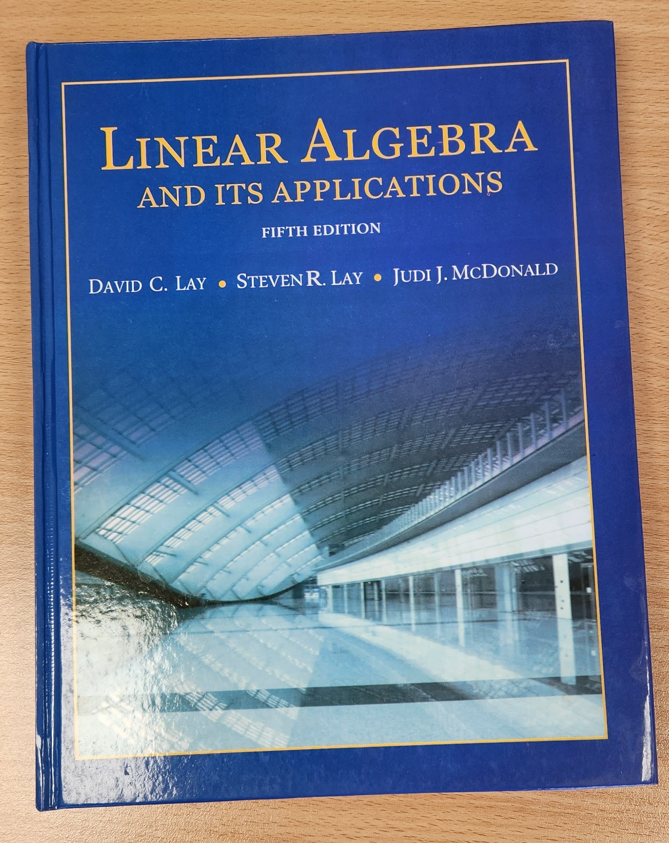

3Blue1Brown on YouTube
https://www.youtube.com/playlist?list=PLZHQObOWTQDPD3MizzM2xVFitgF8hE_ab
Linear Algebra and Its Applications
by David Lay, Steven Lay, Judi McDonald

Slide 8
Lecture (Week 8) (Chapter 6.1.1- 6.2.3)

Slide 9
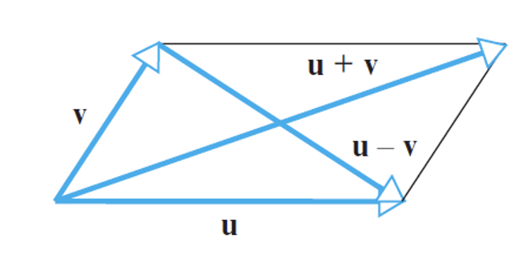
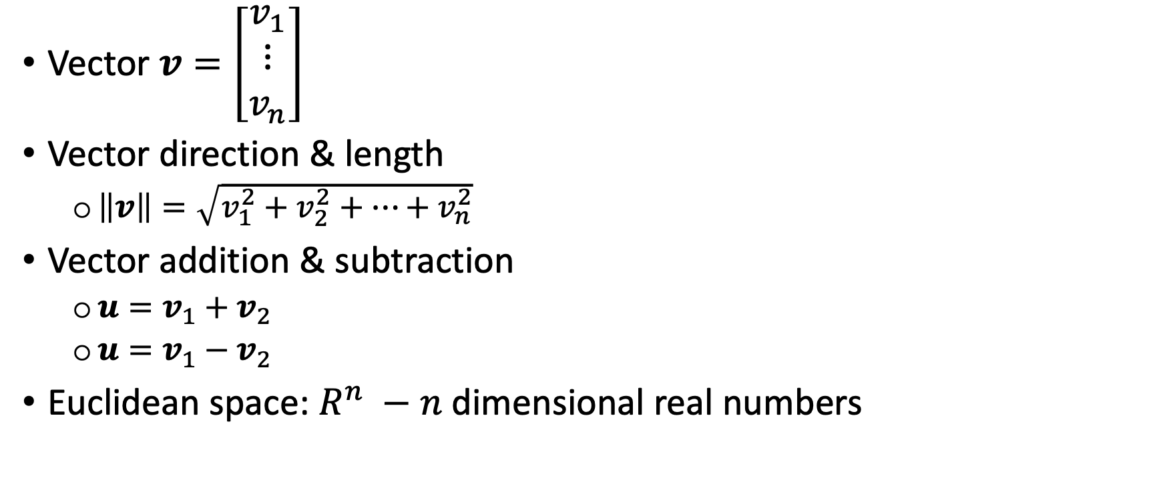
Key points – 6.1.1 Geometric Vectors
Vector $v=\left[\begin{matrix}v_{1} \\ ⋮ \\ v_{n}\end{matrix}\right]$
Vector direction & length
$\left\|v\right\|=\sqrt{v_{1}^{2}+v_{2}^{2}+…+v_{n}^{2}}$
Vector addition & subtraction
$u=v_{1}+v_{2}$
$u=v_{1}−v_{2}$
Euclidean space: $R^{n} −n$ dimensional real numbers

Slide 10
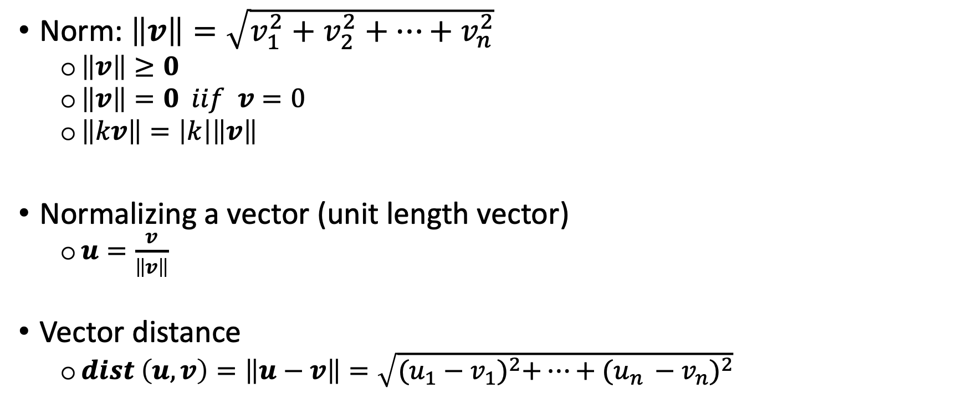
Key points – 6.1.2 Norm (Euclidean Norm)
Norm: $\left\|v\right\|=\sqrt{v_{1}^{2}+v_{2}^{2}+…+v_{n}^{2}}$
$\left\|v\right\|≥0$
$\left\|v\right\|=0 iif$ $v=0$
$\left\|kv\right\|=\left|k\right|\left\|v\right\|$
Normalizing a vector (unit length vector)
$u=\frac{v}{\left\|v\right\|}$
Vector distance
$dist \left(u,v\right)=\left\|u−v\right\|=\sqrt{{(u_{1}−v_{1})}^{2}+…+{(u_{n }−v_{n})}^{2}}$

Slide 11
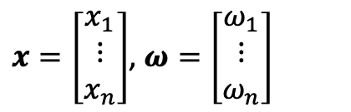
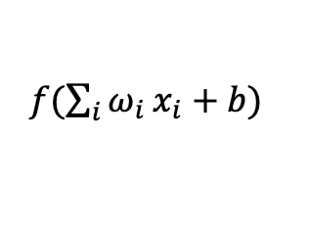
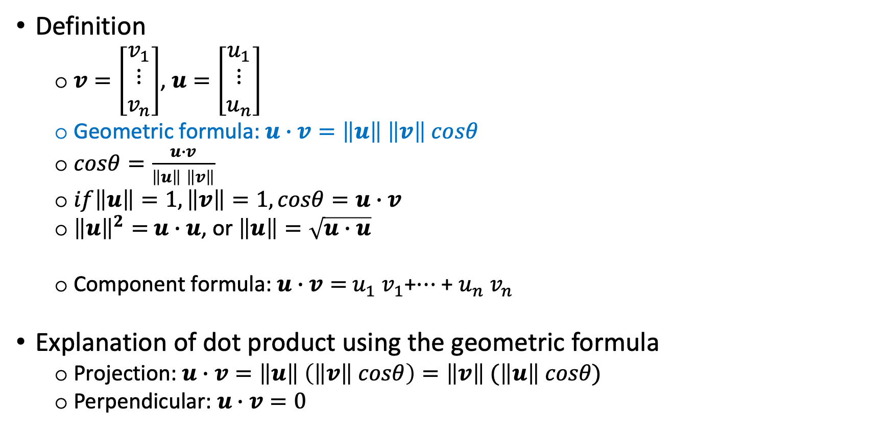
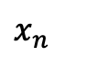
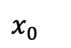
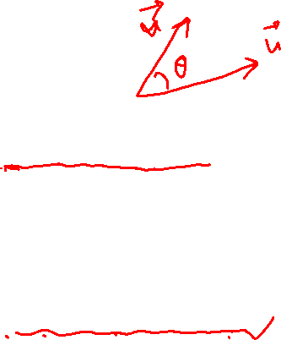
Key points – 6.1.3 Dot Product/Inner Product
Definition
$v=\left[\begin{matrix}v_{1} \\ ⋮ \\ v_{n}\end{matrix}\right]$, $u=\left[\begin{matrix}u_{1} \\ ⋮ \\ u_{n}\end{matrix}\right]$
Geometric formula: $u∙v=\left\|u\right\|$ $\left\|v\right\| cosθ$
$cosθ=\frac{u∙v}{\left\|u\right\| \left\|v\right\|}$
$if\left\|u\right\|=1,\left\|v\right\|=1, cosθ=u∙v$
${\left\|u\right\|}^{2}=$ $u∙u$, or $\left\|u\right\|=\sqrt{u∙u}$
Component formula: $u∙v=$ $u_{1}$ $v_{1}$+$…$ + $u_{n}$ $v_{n}$
Explanation of dot product using the geometric formula
Projection: $u∙v=\left\|u\right\|$ $\left(\left\|v\right\| cosθ\right)=\left\|v\right\| (\left\|u\right\| cosθ\text{)}$
Perpendicular: $u∙v=0$
$x_{0}$
${f(\sum_{i}{ω_{i}}x}_{i}+b)$
$x_{n}$
$x=\left[\begin{matrix}x_{1} \\ ⋮ \\ x_{n}\end{matrix}\right]$, $ω=\left[\begin{matrix}ω_{1} \\ ⋮ \\ ω_{n}\end{matrix}\right]$

Slide 12
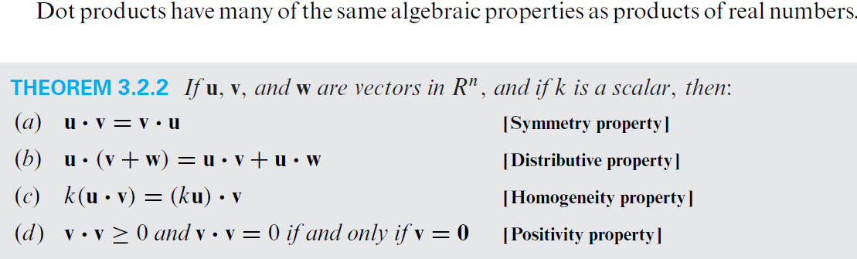
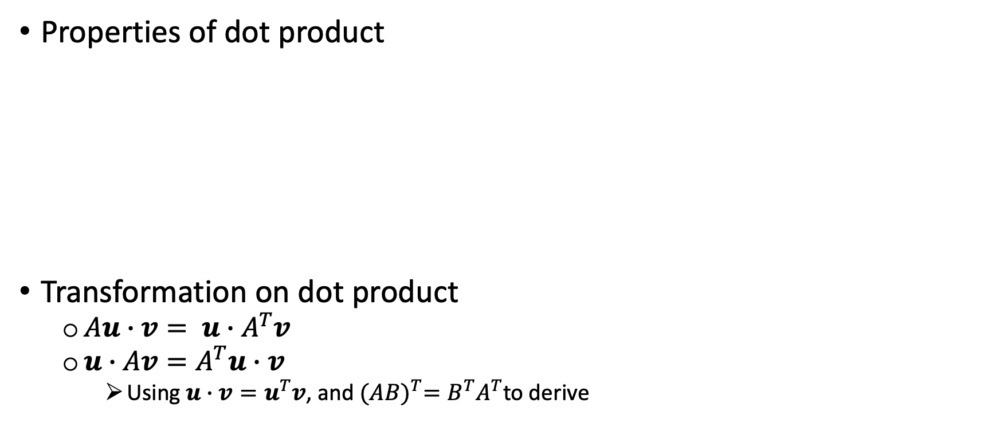
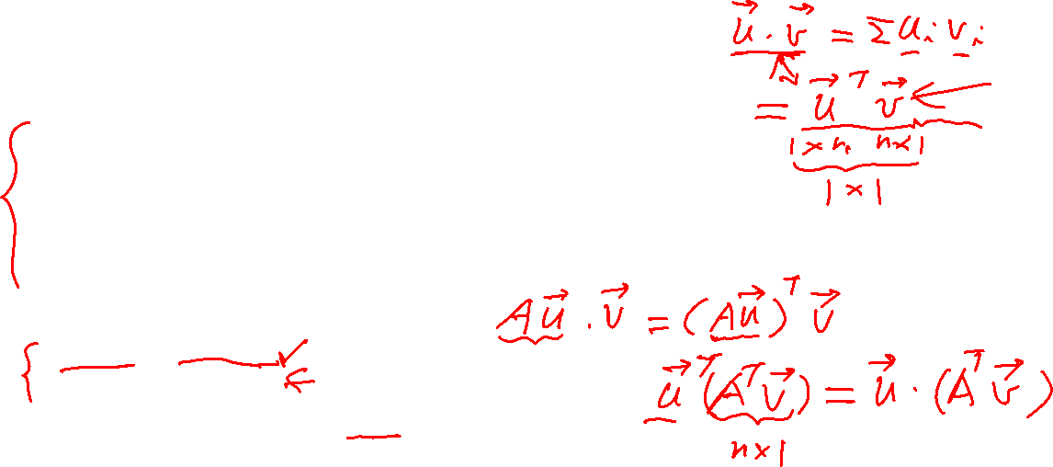
Key points – 6.1.3 Dot Product/Inner Product (2).
Properties of dot product
Transformation on dot product
$Au∙v= u∙A^{T}v$
$u∙Av=A^{T}u∙v$
Using $u∙v=u^{T}v$, and ${(AB)}^{T}=B^{T}A^{T}$to derive

Slide 13
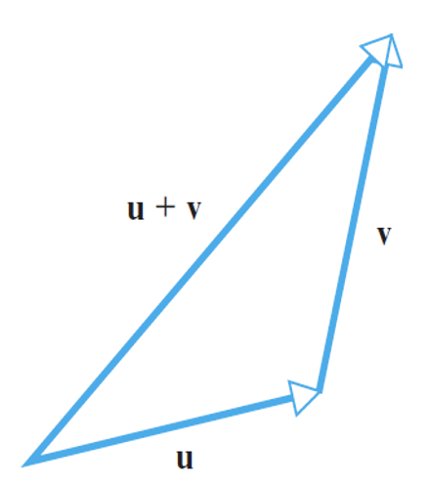
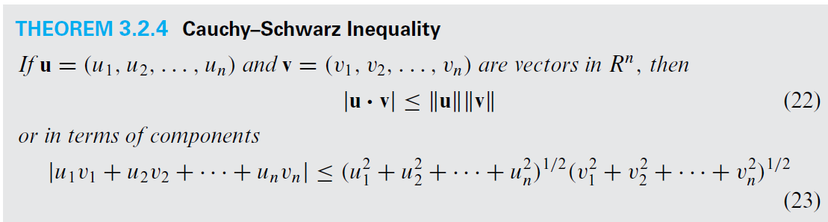
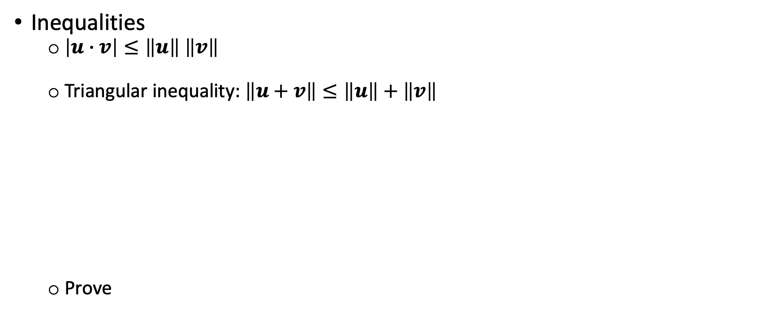
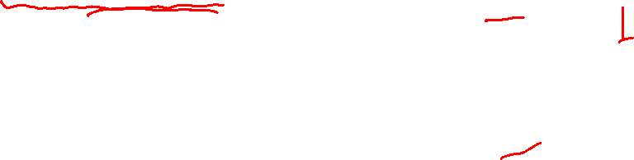
Key points – 6.1.4 Inequalities
Inequalities
$\left|u∙v\right|≤\left\|u\right\| \left\|v\right\|$
Triangular inequality: $\left\|u+v\right\|≤\left\|u\right\|+\left\|v\right\|$
Prove

Slide 14
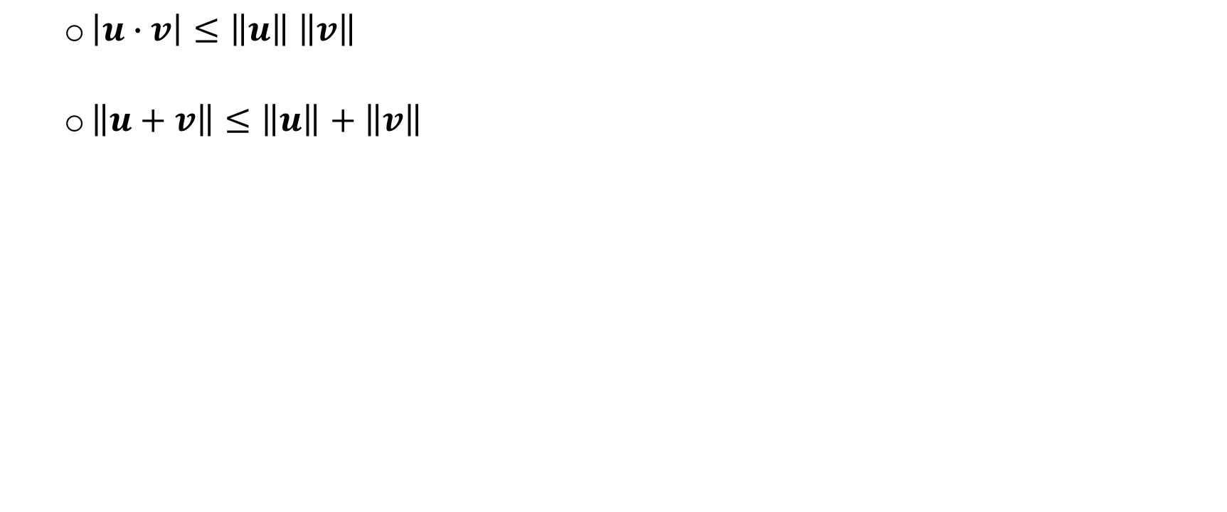
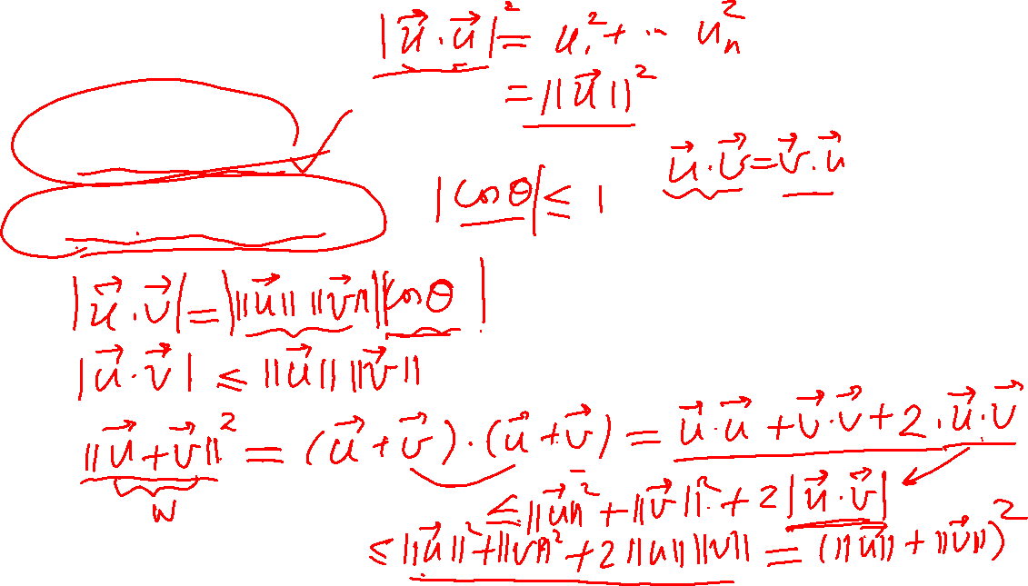
Explain
$\left|u∙v\right|≤\left\|u\right\| \left\|v\right\|$
$\left\|u+v\right\|≤\left\|u\right\|+\left\|v\right\|$

Slide 15
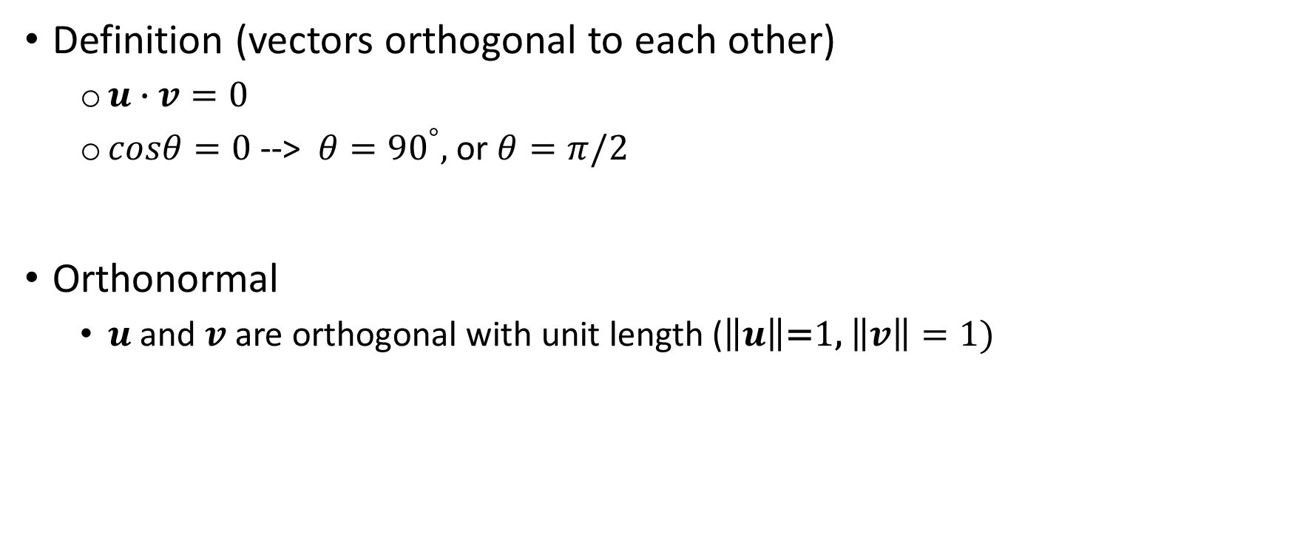
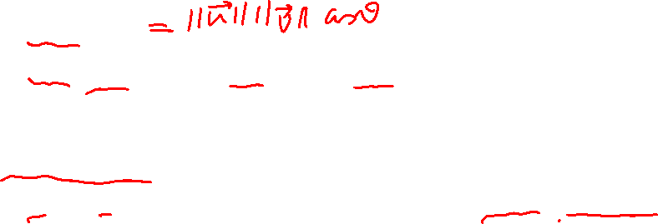
Key points – 6.2.1 Orthogonality
Definition (vectors orthogonal to each other)
$u∙v=0$
$cosθ=0$ --> $θ={90}^{°},$or $θ=π/2$
Orthonormal
$u$ and $v$ are orthogonal with unit length ($\left\|u\right\|\text{=}\text{1}\text{,} \left\|v\right\|=1)$

Slide 16
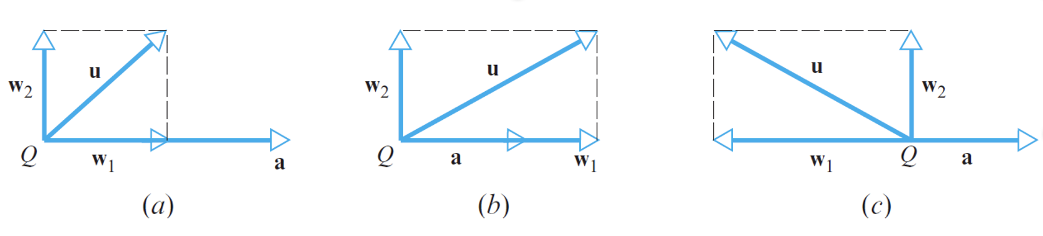
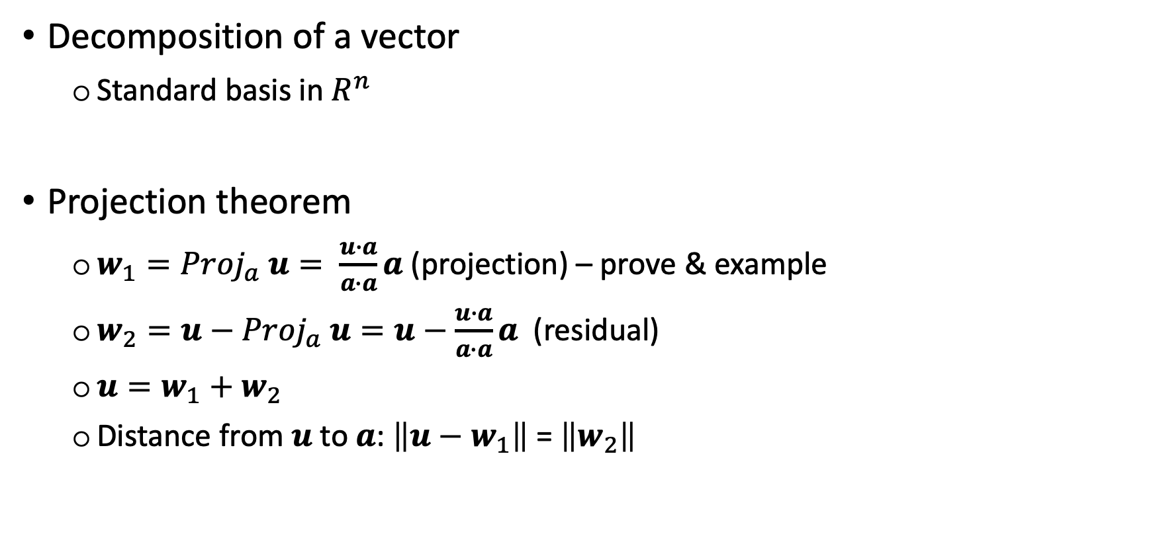
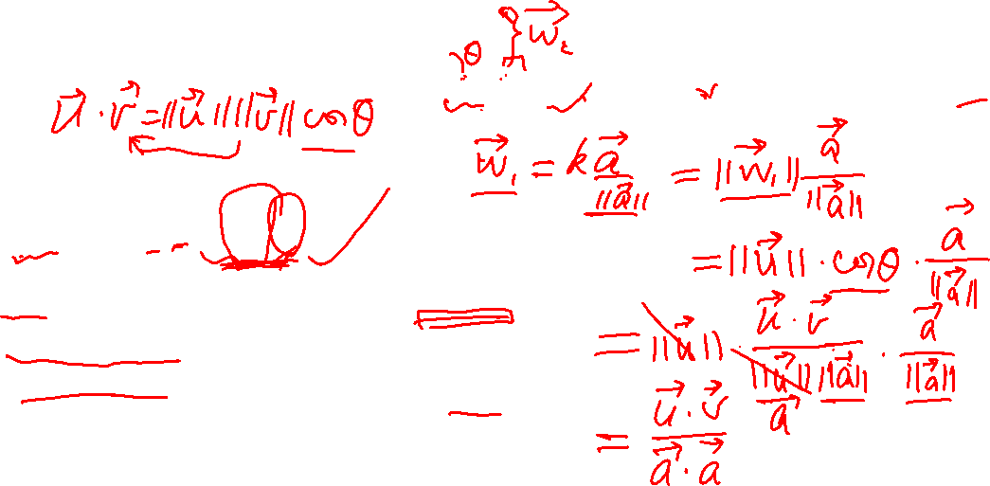
Key points – 6.2.2 Orthogonal Projection
Decomposition of a vector
Standard basis in $R^{n}$
Projection theorem
${w_{1}=Proj}_{a} u= \frac{u∙a}{a∙a}a$ (projection) – prove & example
${w_{2}=u−Proj}_{a} u=u−\frac{u∙a}{a∙a}a$ (residual)
$u=w_{1}+w_{2}$
Distance from $u$ to $a$: $\left\|u−w_{1}\right\|$ = $\left\|w_{2}\right\|$

Slide 17
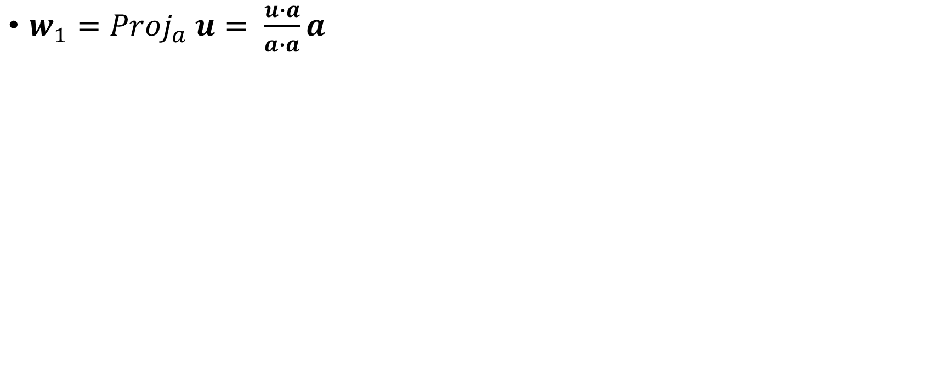
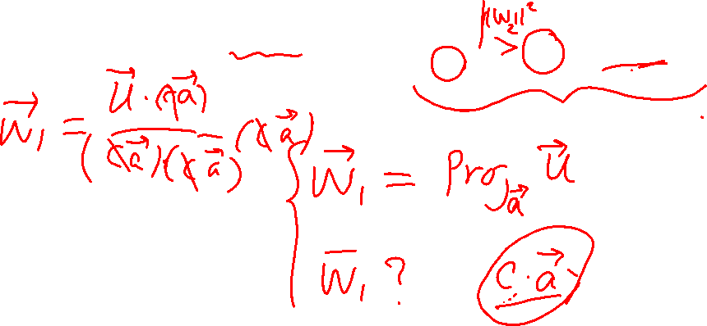
Explain
${w_{1}=Proj}_{a} u= \frac{u∙a}{a∙a}a$

Slide 18
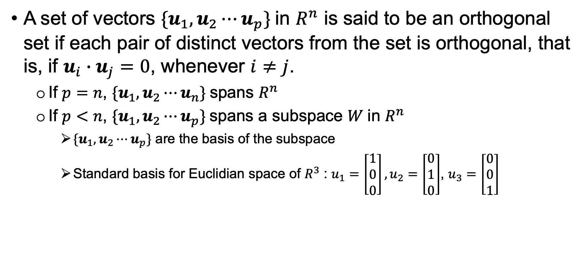
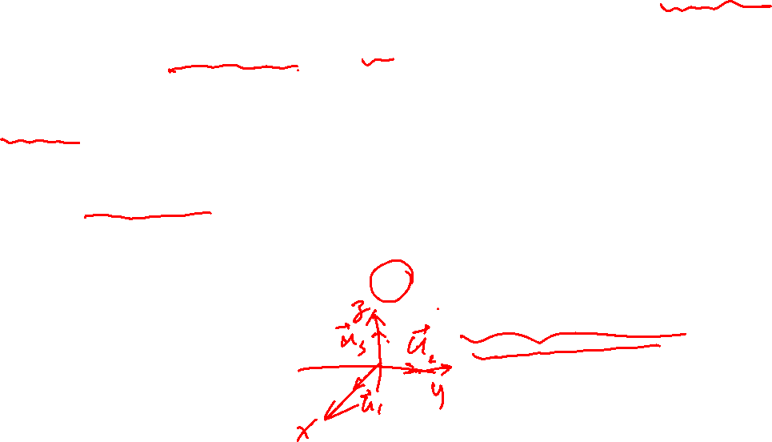
Key points – 6.2.3 Orthogonal Sets and Basis
A set of vectors ${\{u}_{1},u_{2}⋯u_{p}\}$in $R^{n}$ is said to be an orthogonal set if each pair of distinct vectors from the set is orthogonal, that is, if $u_{i}∙u_{j}=0$, whenever $i≠j$.
If $p=n$, ${\{u}_{1},u_{2}⋯u_{n}\}$spans $R^{n}$
If $p<n$, ${\{u}_{1},u_{2}⋯u_{p}\}$spans a subspace $W$in $R^{n}$
${\{u}_{1},u_{2}⋯u_{p}\}$ are the basis of the subspace
Standard basis for Euclidian space of $R^{3}$ : $u_{1}=\left[\begin{matrix}1 \\ 0 \\ 0\end{matrix}\right],u_{2}=\left[\begin{matrix}0 \\ 1 \\ 0\end{matrix}\right]$, $u_{3}=\left[\begin{matrix}0 \\ 0 \\ 1\end{matrix}\right]$

Slide 19
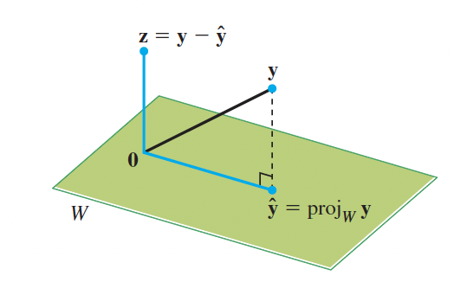
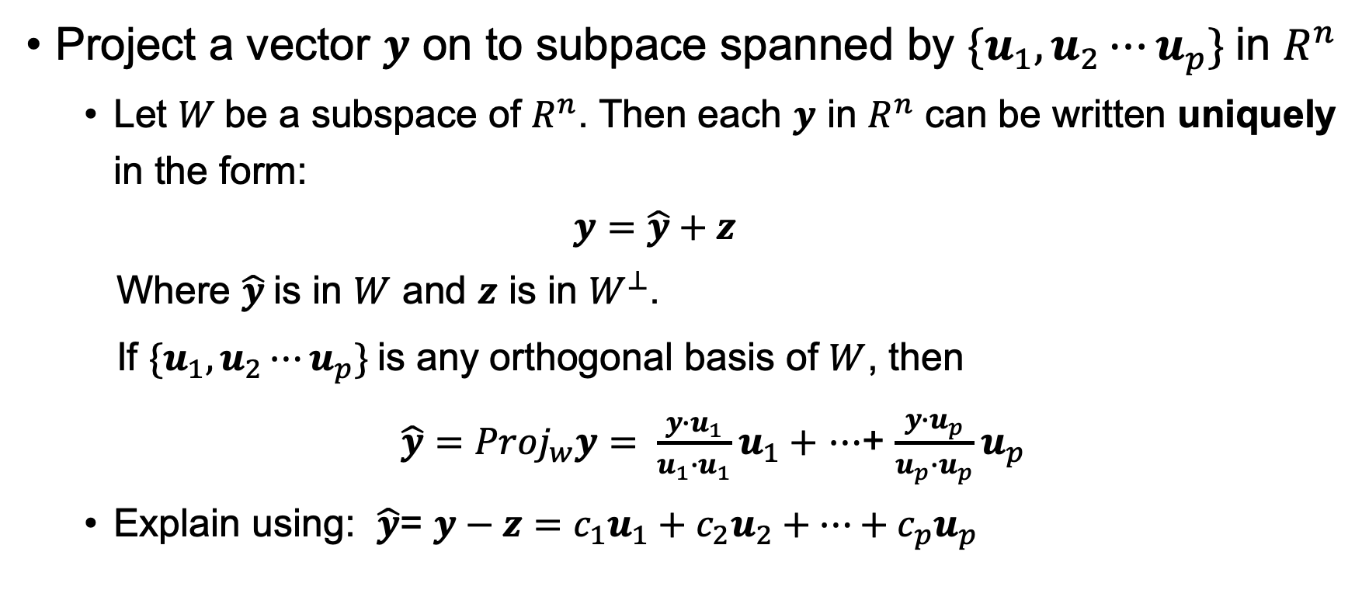
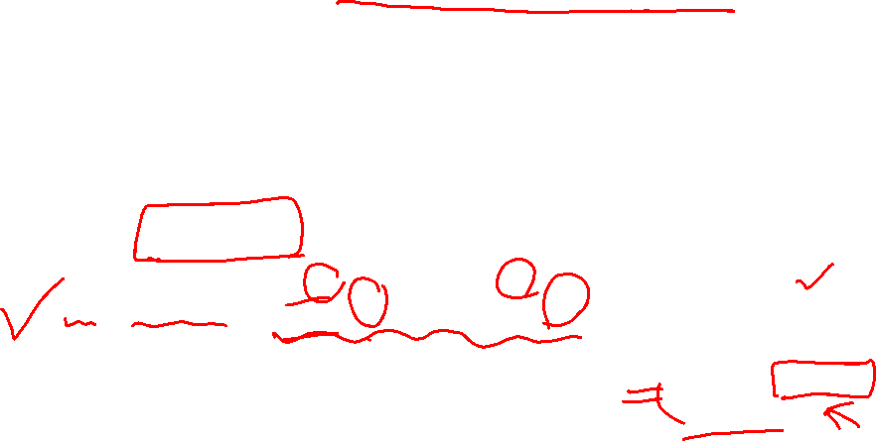
Key points – 6.2.3 Orthogonal Decomposition
Project a vector $y$ on to subpace spanned by ${\{u}_{1},u_{2}⋯u_{p}\}$in $R^{n}$
Let $W$be a subspace of $R^{n}$. Then each $y$ in $R^{n}$ can be written uniquely in the form:
$$y=\hat{y}+z$$
Where $\hat{y}$is in $W$ and $z$ is in $W^{⊥}$.
If ${\{u}_{1},u_{2}⋯u_{p}\}$is any orthogonal basis of $W$, then
${\hat{y}=Proj}_{w}y= \frac{y∙u_{1}}{u_{1}∙u_{1}}u_{1}+$ $⋯$+ $\frac{y∙u_{p}}{u_{p}∙u_{p}}u_{p}$
Explain using: $\hat{y}$= $y−z={c_{1}u}_{1}+{c_{2}u}_{2}+⋯+c_{p}u_{p}$

Slide 20
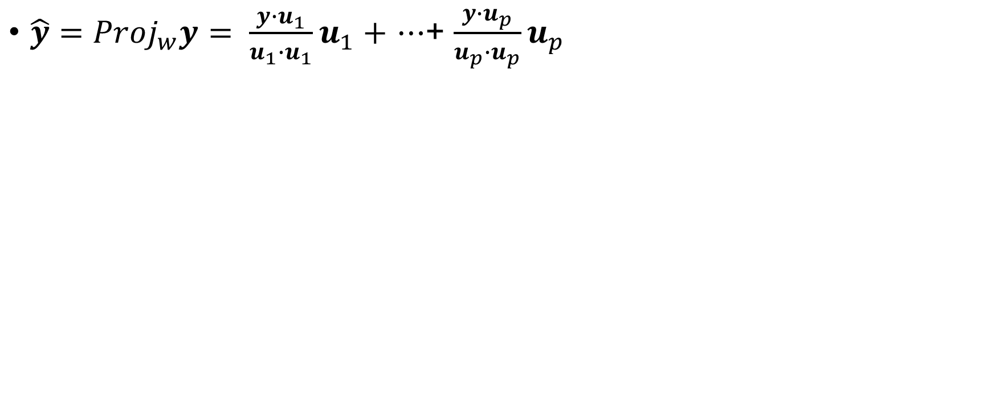
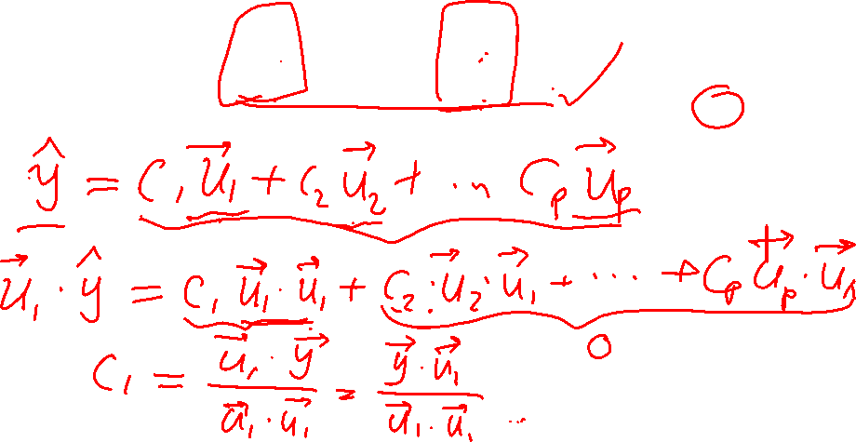
Explain
${\hat{y}=Proj}_{w}y= \frac{y∙u_{1}}{u_{1}∙u_{1}}u_{1}+$ $⋯$+ $\frac{y∙u_{p}}{u_{p}∙u_{p}}u_{p}$

Slide 21
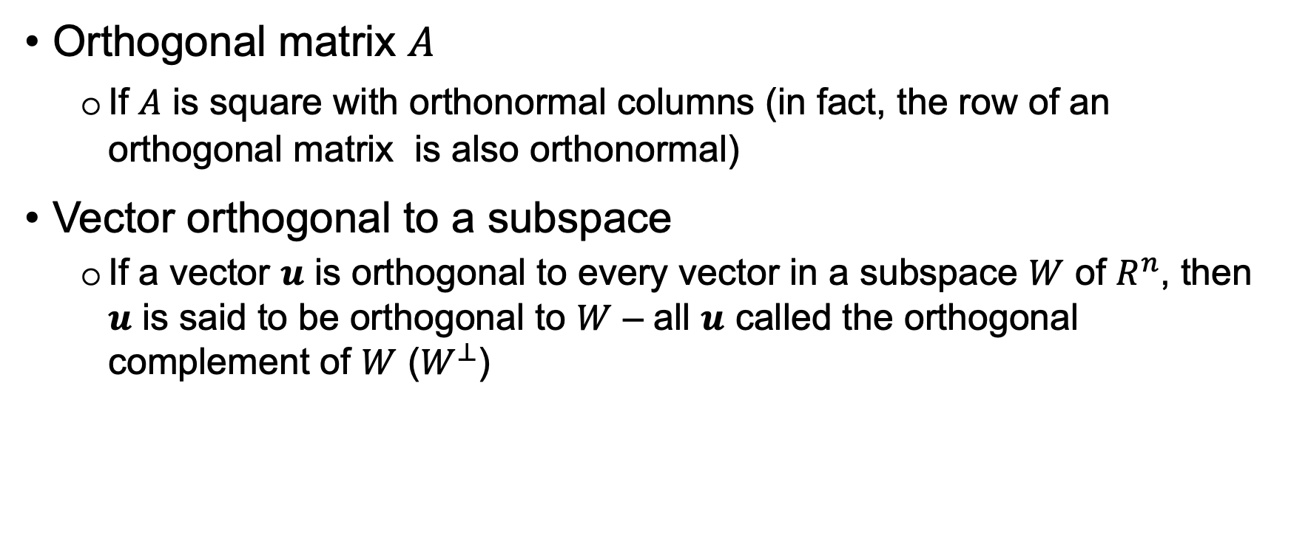
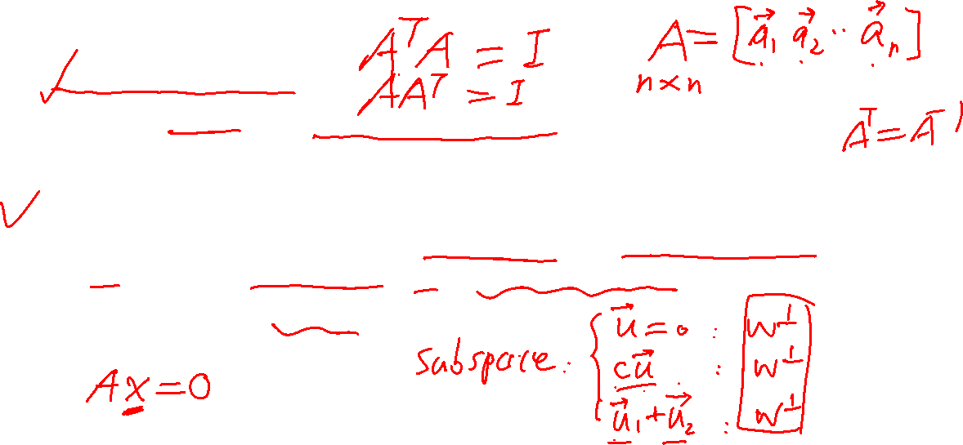
Key points – for tutorial questions
Orthogonal matrix $A$
If $A$ is square with orthonormal columns (in fact, the row of an orthogonal matrix is also orthonormal)
Vector orthogonal to a subspace
If a vector $u$ is orthogonal to every vector in a subspace $W$ of $R^{n}$, then $u$ is said to be orthogonal to $W$ – all $u$ called the orthogonal complement of $W$ ($W^{⊥}$)

Slide 22
End

